Slide 1

Resume Project Challenge
# Challenge : Provide insight to marketing Team of “CodeX” Company.
Domain: Food & Beverages Industry
Function : Marketing
Tools Used : MySQL , Power BI, Power point
Presented by: Richa Srivastava

Slide 2
About the Company
CodeX is a Germany based company that is aiming to make its mark in Indian market. A few months ago they launched their energy drink in 10 cities in India.
Their Marketing team is responsible for increasing brand awareness, market share, and product development. They conducted a survey in those 10 cities and received results from 10k respondents..

Slide 3
Task Scheduled
As marketing data analyst’s job is to collect the data given from the survey , clean it and derive meaningful insights from it which will help the company to make better business decision and enable it to increase its revenue.
Here I am assuming myself as Peter Pandey, a marketing data analyst who is tasked to convert these survey results to meaningful insights which the team can use to drive actions

Slide 4
Insights from Project
Demographic Insights
Consumer Preference
Competition analysis
Marketing Channel & Brand Awareness
Brand Penetration
Purchase Behaviour
Product Development
Recommendation
Indian Market Overview

Slide 5
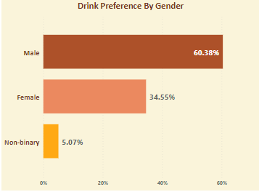
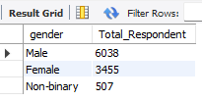
Demographic Insight
Who prefers energy drink more?
As we can see from the graph and SQL result that among different gender ,males have higher preference for energy drink ,followed by female and non-binary .

Slide 6
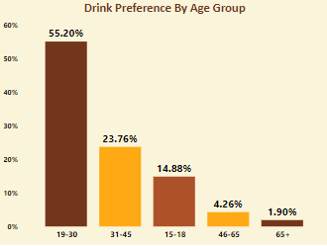
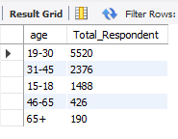
Demographic Insight
Which age group prefers energy drink more?
It is evident from the insights gathered that age group 19-30 prefers more followed by 31-45,15-18 and so on. Therefore age group 19-30 should be focused more .

Slide 7
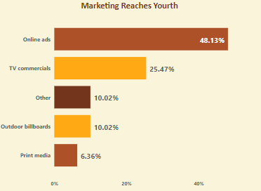
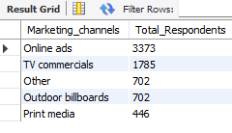
Demographic Insight
Which type of marketing reaches the most Youth (15-30)?
We can clearly see that for the youth online ads are the most appropriate marketing strategy as todays youth are mostly using the internet for their day to day whereabouts.

Slide 8
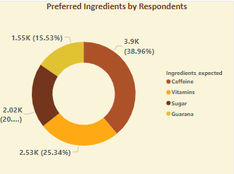
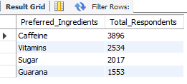
Consumer Preferences
What are the preferred ingredients of energy drinks among respondents?
Caffeine marks the highest i.e. 38.96 % in preferred ingredients list , followed by Vitamins which shows that caffeine and vitamins should be focused in drink in order to make it likeable to people.

Slide 9
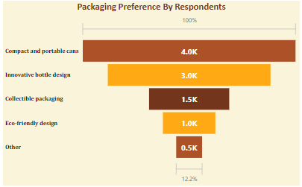
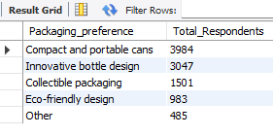
Consumer Preferences
What packaging preferences do respondents have for energy drinks?
Compact and portable cans are mostly preferred as they are handy , can be easily recycled and used effortlessly.

Slide 10
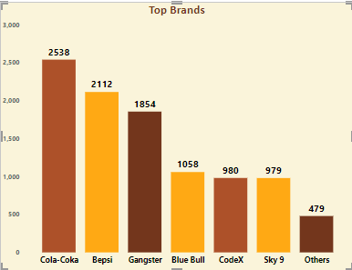
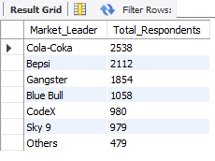
Competition Analysis
Who are the current market leaders?
Cola-Coka ,Bepsi and Gangster are the top 3 market leaders in this industry. We can also find from the upcoming insight that our current competition is Sky9 energy drink.

Slide 11
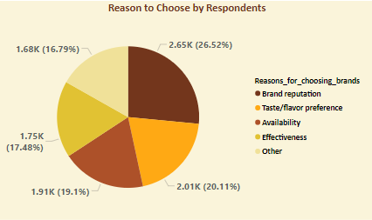
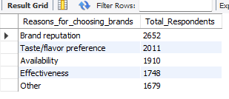
Competition Analysis
What are the primary reasons consumers prefer those brands over ours?
The foremost reason is Brand Reputation as they are in market for longer period of time and have made their mark . So , being a new company we can mostly work on our drink’s flavour and its availability in market which will encompass other reason as well.

Slide 12
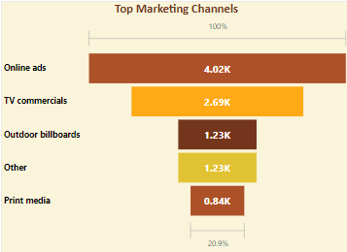
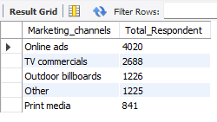
Marketing Channels & Brand Awareness
Which marketing channel can be used to reach more customers?
Online ads and TV commercials are the marketing channels that are reaching mostly to the customer due to digitalisation & modernisation of current era.

Slide 13
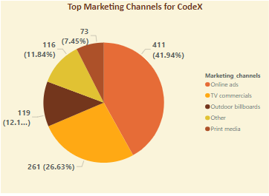
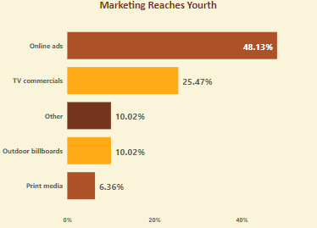
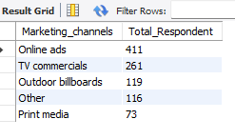
Marketing Channels & Brand Awareness
How effective are different marketing strategies and channels in reaching our customers?
Online ads and TV commercials are the marketing channels that are reaching mostly to the customer and are highly effective as 48.13% of youth are included who are the consumer of drink.
Note: The above data if of CodeX specifically

Slide 14
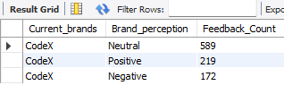
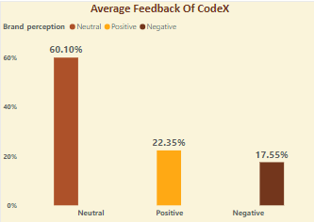
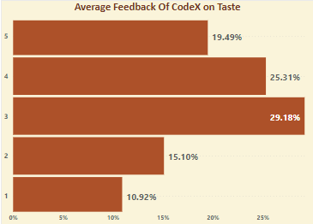
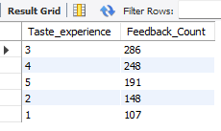
Brand Penetration
What do people think about our brand?
So, I have found out our brand rating on basis of two factor ie. Brand Perception & Taste Experience which are equally important .We can see that our band is neither in great condition nor in bad we are doing good as we got neutral rating in both domains

Slide 15
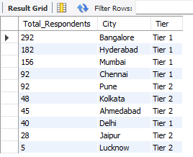
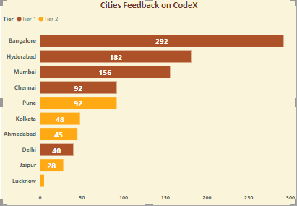
Brand Penetration
Which cities do we need to focus more on?
From the insight we can see that we are doing good in Bangalore & Hyderabad in tier 1 and in Pune & Kolkata in tier 2 . So we need to focus more on Delhi in Tier1 city and in Jaipur &Lucknow in tier2 cities.

Slide 16
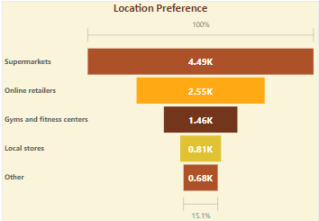
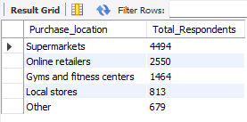
Purchase Behaviour
Where do respondents prefer to purchase energy drinks?
Supermarkets is the most preferred to purchase energy drink

Slide 17
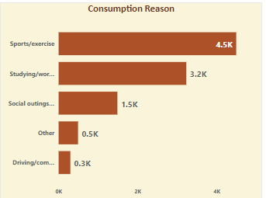
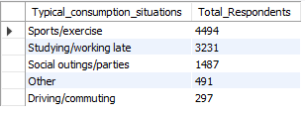
Purchase Behaviour
What are the typical consumption situations for energy drinks among respondents?
As our product is energy drink so, it is mostly consumed while having some physical exercise as we can see from graph ie sports/exercise.

Slide 18
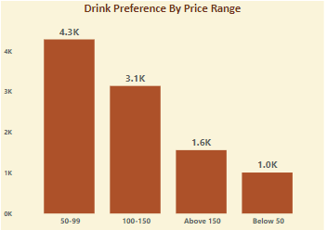
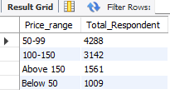
Purchase Behaviour
What are the preferred price range for energy drinks among respondents?
50-99 is the price range which is doable for every age group.

Slide 19
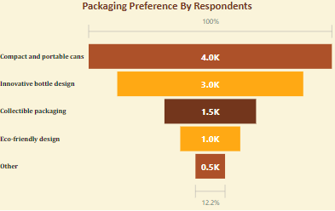
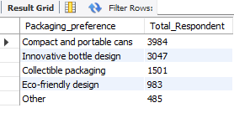
Purchase Behaviour
What factors influence respondents' purchase decisions, such as price range and limited edition packaging?
50-99 is the price range which is doable for every age group along with compact & Portable cans packaging. We can also depict that there is inverse relationship between price & Respondents.

Slide 20
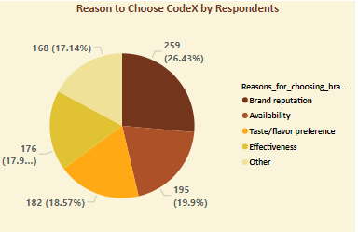
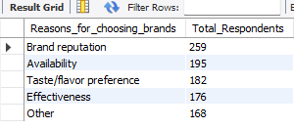
Product Development
Which area of business should we focus more on our product development?
Taste/flavour preference and Effectiveness along with some other things are the domain in which we need to work on.

Slide 21
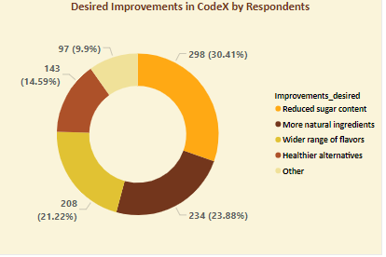
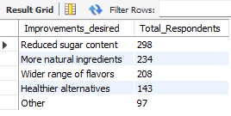
Recommendation
Immediate improvements we can bring to the product
We need to reduce the sugar content and add more natural ingredients to our drink.

Slide 22
Recommendation
After going through the data we can clearly depict few insights and use them to help company to make meaningful business decision. CodeX should look into the insights mentioned below:
First and foremost company should mostly focus on youths ie age group of 15-30 who are primary consumers of energy drinks. Along with that as we have inverse relationship with price range ,therefore price range should be nearly between 50-99 Rs for 250 ml quantity and decreasing price along with quantity to expand the reach .
Making packaging compact and portable like cans ,as it becomes convenient and allow drinks to stay fresh for longer time frame. This also saves leaking or tearing issues while travelling . Using attractive and eye catching graphics on cans also create curiosity among consumers.
Marketing plays a key factor in branding thus , social media presence becomes must as our targeted audience are young people who are always on their phone. Always staying connected with consumer via creating memes as they are trendy and never out of fashion . Another very catching thing is giving slogans to your product like, ” Red Bull gives you wings” which never lets brand out of sight. Making someone brand ambassador also helps to spread word about your brand but, it should be someone whose word of mouth matters and should match with brands values .

Slide 23
Recommendation
Influencers marketing is also great way as its social media era , we can send sample product to them and have their unbiased and authentic view about product , if they like it then they will be given coupon codes for their audience by which both of us will be benefitted.
As we earlier saw that supermarkets are the most preferred location for buying the drinks , we can set up stalls there on weekends where customer can try drinks for free as sample and can have some discount or some combo offer if they want to buy it.
Last but not the least we need to work on our drink’s flavor and taste. As working on all other factors will be beneficial only if our drink is worth it. Making it health conscious by lowering sugar and calorie content , along with adding vitamins , minerals & anti oxidants being there is large market for the health freaks as often they are indulged in some physical activity where energy drink is mostly consumed via survey.
Introducing various flavor also adds ambiguity among consumers and adding caffeine , guarana in appropriate amount for improving drink quality and maintaining health benefits.

Slide 24
Indian Market Overview
The Indian energy drink market has seen steady growth in recent years, with a CAGR of 8.5% from 2016-2021 . The market is estimated to grow at similar rate in coming years. Some estimates suggest that market size in India is estimated at Rs 2400 crore, growing at CAGR of 45-50%.
Indian market is dominated by a few major companies like Red Bull , Monster Energy ,Coca-Cola & Gatorade . These brands hold most of the market share , Red Bull being dominating holding 61% of market. Another growing brand which is quite popular among teenagers is Sting capturing 7% of market share.
Target audience of energy drinks are primarily young adults of age group 18-35, looking for quick energy boost .
Another trait of consumers who are considering these are health- conscious one as these drinks are now having low sugar content ,low calories , vitamins, minerals & anti-oxidants.
These energy are now consisting of various flavor along with its compact size makes it handy , which becomes an add on.

Slide 25
Thank You
&
Feedbacks Please!

